Slide 1

DriverPass System Analysis
Rolesshania Jackson
Notes:
[No speaker notes required for this slide.]

Slide 2

System Requirements
Functional Requirements
Users can schedule driving lessons and tests via the app
Instructors can update lesson status and provide feedback
Non-functional Requirements
The app must respond within 2 seconds for all user actions
Data must be stored securely using local encryption and SQLite
Notes:
Functional Requirements describe what the system should do. Users must be able to schedule driving lessons and tests directly through the app. Then instructors need the ability to update lesson statuses and provide feedback, which ensures transparency and progress tracking.
Nonfunctional Requirements focus on how the system performs. Requiring user actions such as booking or updating.

Slide 3
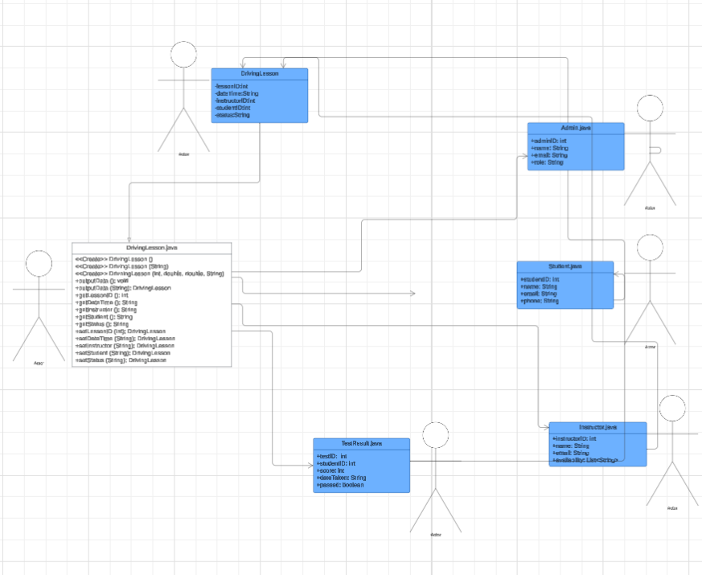
Use Case Diagram
[Insert your use case diagram here.]
Notes:
Admin: A staff member who monitors everything, approving lessons, managing users and maintains the organization
Instructor: A teacher who gives lessons. The system tracks when they’re available so students can book time slots
Student: A learner who signs up, books lessons and takes deriving test. Their contact information is stored so instructors and admins can reach the
Driving Lesson: Is the core of the system. Each lesson has a unique ID, a scheduled date and time, and links to both the student and instructor.
Test Tracking: After Student takes a driving test, their score, date, and pass/fail results are recorded here.

Slide 4
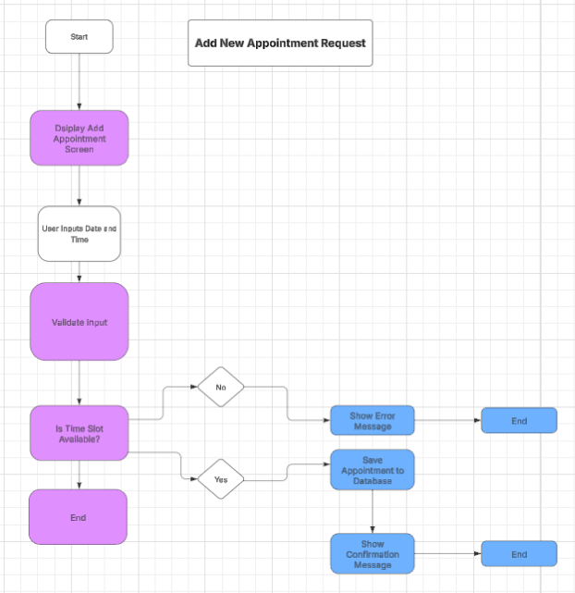
Activity Diagram
[Insert one of your activity diagrams here.]
Notes:
The diagram shows what happen when a student wants to request an appointment for driving lesson. First , its starts when the student opens the appointment request screen and enters their preferred date/time. System will check to make sure the input is valid for example time format and correct time. The it check whether the selected time slow is available. If the time isn’t, the student sees an error message and can try again but the time slot is available, the system saves the request and provides confirmation. Remember that this process helps ensure the appointment are scheduled smoothly and the instructors are double-booked, and the student has a better simple, clear experience when making appointments.

Slide 5
Security
Only verified users can access their accounts
Appointment requests are checked before being saved
Student and instructor information is private
Test results are only visible to authorized staff and student
Admins have special access to manage sensitive data
The system prevents double-booking and invalid entries
Notes:
-Providing Security and Privacy in mind, always make sure you are verifying users, only can those users log in and access their information. ( goal: prevent unauthorized access)
-When students request appointments, they system checks everything before saving (goal: authorization is mandatory, and errors/ conflicts are avoided)
-Privacy of student and instructor information such as email, phone numbers are kept private and maintain top priority.
Test scores are only visble
Admins have special access to manage sensitive data, but regular users can only see whats relevant

Slide 6
System Limitations
Only works on Android devices (pending expansion to other iOS platforms)
Data is stored locally, not backed up online
Requires permission to send text messages
No built- in chat feature between students and instructors
Limited offline functionality
Notes:
While DriverPass offers a lot of helpful features, there are a few things it doesn’t do yet. Right now, the app only applies to Android phones/tablets. We plan to add support for iOS in the future. All data is saved directly on the device, which means there’s no automatic online backup. If a phone is lost or reset, the data could be lost too. The application needs permission to send text, so users must allow that feature for appointment reminders to work. Built in chats have become easier when users need assistances offline. But to also include, the app has limited offline features, meaning needing internet connection for some tasks. Quick communication are helpful all around. These limitations help us keep the system simple and focused for now, but we’re planning updates to make it even flexible connects

